Slide 1
Introduction to
Windows SharePoint Services 3.0
Notes:
How many people are actually using SharePoint? Developing with it?
This presentation is written for people who have little to no experience with SharePoint. It’s an overview of what it can do.
If you’re already using it and have a good understanding of its structure, you’re probably not going to get anything from it.
It’s sort of a counter to the general sense of “SharePoint sucks!” I get from other developers.
Personally, I don’t think it’s the greatest thing ever, but I find that I love it as much as I hate it.
If you do stay, your input is appreciated, because my actual development experience with SharePoint is limited to one or two things.
Also, a lot of my suggestions as to implementation and use are merely my own opinions, so feel free to interject.

Slide 2
Outline
What is SharePoint?
Basic Site Structure
Additional Features
Development Strategies
Resources and Tools
Notes:
We’re going to briefly cover what SharePoint is. Including the confusing line between Windows SharePoint Services and Microsoft Office SharePoint Server.
Site Structure and Hierarchy. What are the raw materials that SharePoint gives us to organize our server, store data, or control users’ access to it?
Additional features. Things like Web Parts, Workflow, and the API that we can use to extend SharePoint—either by downloading existing code, or developing our own.
Development strategies. Like I said, I’ve heard a lot of people say SharePoint sucks. And it does suck for a lot of things. You will not be replacing your existing applications with SharePoint sites. You do have to apply the principle of “the right tool for the job.”
Resources and Tools. Where can you go to learn more, and what tools can you use to get started extending SharePoint?

Slide 3
What is SharePoint?
Provides collaboration features through a web-based interface
Also integrates with Microsoft Office
Manages lists and documents in a central location
So, SharePoint serves to replace some functions of file shares, forums, wikis, calendars, organizers, and email.
Notes:
Collaboration simply meaning a central place to store information and files.
It’s built-in, so you’re not installing extra plugins. We’ll be covering this a bit in the features; Microsoft has a white paper called “Good, Better, Best” that explains how WSS integrates with both Office 2003 and Office 2007.
The support is better in Office 2007. Hence the “better, best” part of that title, because obviously they want you to upgrade to Office 2007.
All the files and data about a particular department, or project, or meeting, all in one place. Don’t get too hung up on this, because it’s not really much more centralized than storing files on a fileshare, depending on how you’re managing it. We’ll get more into this later.
It won’t replace all of them completely, but it serves many of the same purposes—plus it’s more centralized, built upon existing .NET and Windows features, and has an API for interacting with it from your applications.
Email—obviously it’s not meant to replace it. But where does everyone store all of the files that get passed around? In email. So it’s an alternative to that, if you can provide the support and training to make it usable, and if people actually use it. Which is always the trick.

Slide 4
What is SharePoint?
SharePoint is a platform
  It’s a tool for solving problems, not a solution to a problem
  It can be extended using ASP.NET / .NET
  But it’s not a replacement for ASP.NET and SQL Server
Notes:
This is an important concept.
It’s not like HR or accounting or inventory tracking software. It doesn’t solve a problem out of the box. You still have to gather requirements, design a solution, and implement it. It just makes the implementation easier.
Likewise, it’s not going to force users to make use of it, or do things the right way, or follow process. You’re going to have to provide support and training adequate for your use of it.
It’s built on ASP.NET 2.0, so you can extend it with .NET. That doesn’t mean it’s easy--but we’ll get into that in a bit.

Slide 5
WSS 3 vs. MOSS 2007
WSS is included with Windows Server; MOSS requires additional licensing
MOSS is a set of additional features built on top of WSS
We’re focusing on WSS in this presentation
Notes:
MOSS Features:
Internal social networking
Aggregating data from multiple sites into a “portal”
Indexing and searching data in various file types
Document management, including workflow, rights management, retention, auditing, etc.
Collecting data from InfoPath forms
Publishing business data
WSS on EODTWEBVM1, MOSS on WEBDEV

Slide 6
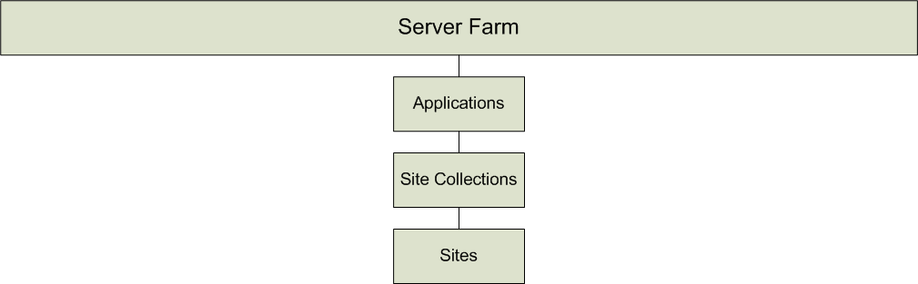
Site Structure
Notes:
Physical structure; this is the infrastructure of SharePoint.

Slide 7
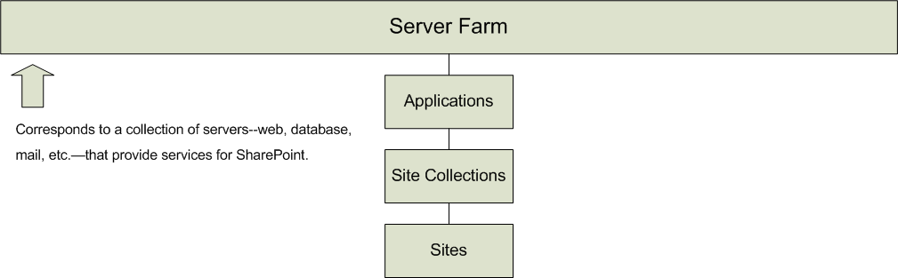
Site Structure
Notes:
Server Farm is the basic unit of a SharePoint installation.
This can actually be just one server running SQL Server, IIS, and SMTP.
WSS installer has a standalone server option that includes SQL Server Express.

Slide 8
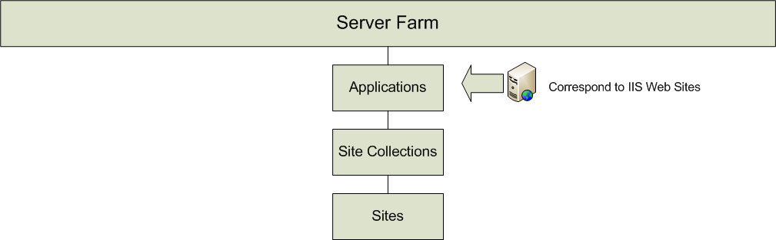
Site Structure
Notes:
Applications correspond to IIS web sites.
SharePoint will configure IIS for you, all you have to do is create the applications.

Slide 9
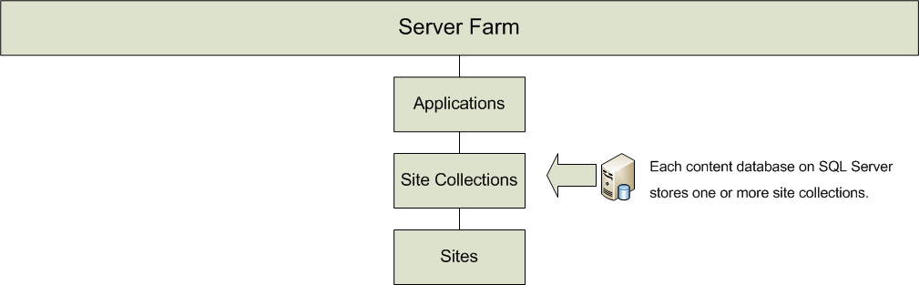
Site Structure
Notes:
An application needs a defined site collection before it can actually be used.
Applications contain content databases, and content databases contain site collections.
Generally you’ll only need one content database, unless there are circumstances that require you to worry about which site is in which database.
Otherwise, SharePoint administration mostly hides these details from us.

Slide 10
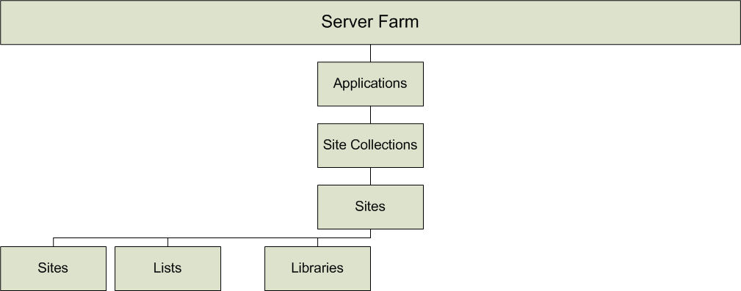
Site Structure
Notes:
As far as basic, logical structure is concerned, sites contain three things: sites, lists, and libraries.
Sites can contain other sites, even ones with different permissions. So you can build a hierarchy of sites to suit your organization’s requirements.
Lists and libraries correspond somewhat to tables, if we’re thinking in database terms. They’re not, for a variety of reasons.

Slide 11
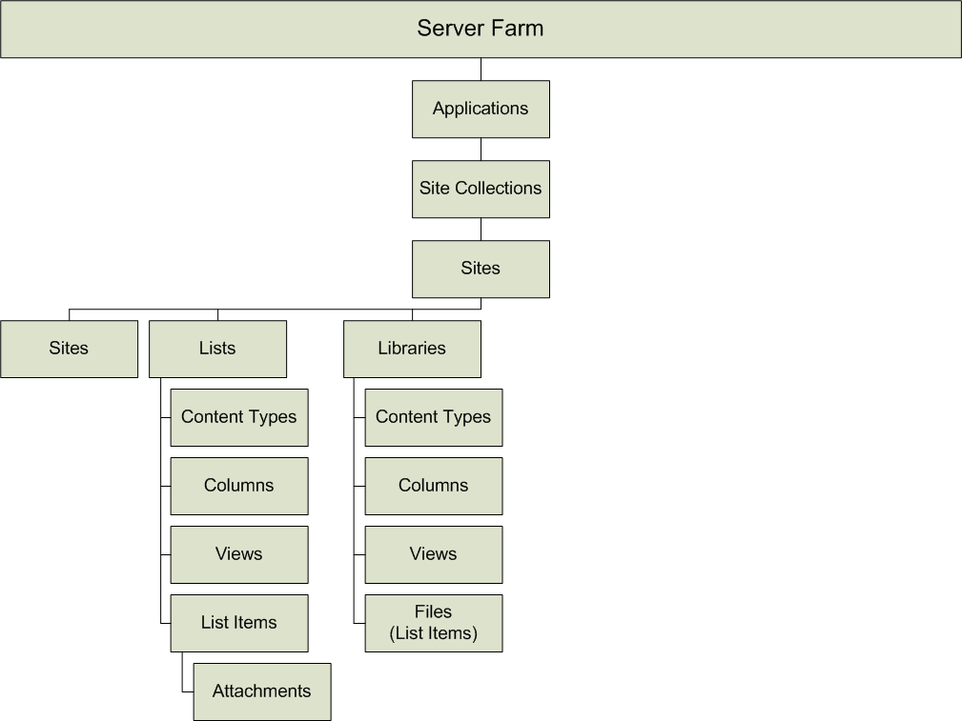
Site Structure
Notes:
Lists and libraries are similar. Lists are primarily for data, while libraries are for files and documents.
Within each list, you can define columns to store additional data. We’ll go into a little more detail in a bit.
Content types specify a collection of columns that a particular item may have.
This doesn’t have to include all of the columns defined for the table, just the ones applicable to the type of data you’re storing. Sort of like class inheritance, but in reverse—the list defines all the members, and the content types define a subset of those.
Views define a particular way of sorting, filtering, and displaying data from a list.
Finally, we have List Items, which represent the actual data in the list.
In lists, you can also attach files to items.

Slide 12
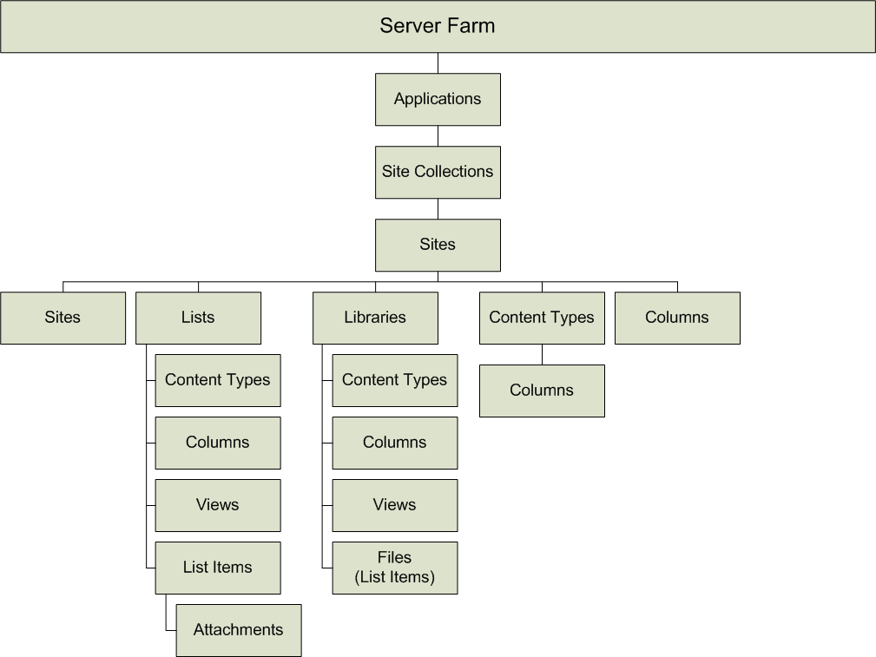
Site Structure
Notes:
For reusability, you can define content types and columns at the site level, and then apply them to lists within the site or its subsites.

Slide 13
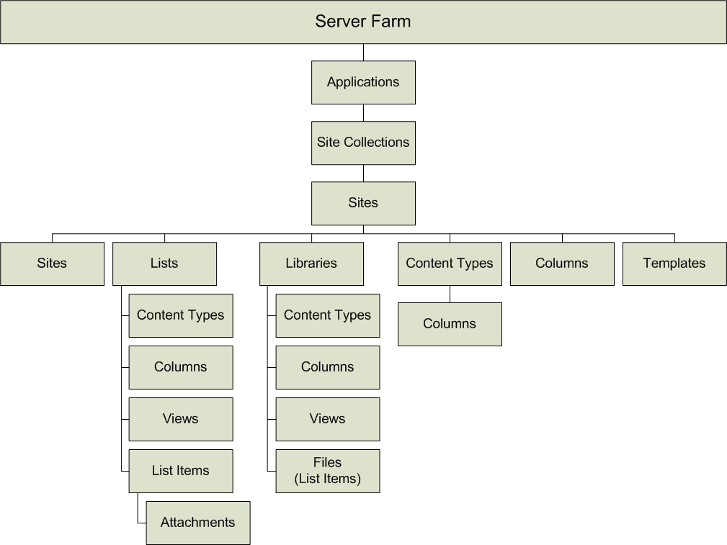
Site Structure
Notes:
You can also save a list or site as a template, so that later lists or sites can be built the same way.
Extremely valuable as your SharePoint usage grows. Allows you to standardize.
Foresight on your site structure and reuse can be the difference between effective implementation and uncontrolled growth.

Slide 14
Lists and Libraries
SharePoint’s main feature
Several built-in types covering common uses
  Announcements
  Contacts
  Discussion Board
  Links
  Calendar
  Tasks

Slide 15
Lists and Libraries
Include useful features
  Attach files to list items
  Versioning and check-in/check-out
  Export to Excel and open in Access
  RSS feeds and email alerts
  Document Libaries open in Windows Explorer
  Calendars open in Outlook 2003 or 2007
Notes:
Here’s where SharePoint really becomes a time-saver. Think about how long it would take to code a stable, working version of each of these features into your application.
“If it isn’t in Excel, it isn’t real.”
Uses Excel’s querying feature. Good way for users to take the data and manipulate it into something they can report on.
Support for calendars in outlook 2007 is much better than 2003, but it’s available in both places.
Outlook 2007 will allow you to overlay it with existing calendars, and also allow the ability to add or edit calendar items.

Slide 16
Column Types
Basic column types include text, choice, number, date/time, yes/no, and hyperlink
Lookup columns allow you to reference items from other lists
Calculated columns allow you to write formulas using other column values
Still, SharePoint isn’t Excel, Access, or SQL Server
Notes:
Basic column types are familiar to anyone who’s used SQL Server, Excel, or Access.
You might call choice “enum,” or “yes/no,” boolean or bit—you can see that these are a little more oriented towards users than developers.
Lookup columns are a lot like foreign keys, but they’re not. As we’ve said, lists are like database tables, but they are not database tables.
Calculated column formulas are very similar to Excel formulas.
SharePoint isn’t Excel, Access, or SQL Server:
Lookup columns don’t enforce relationships like foreign keys do.
You don’t have access to quite as many formulas as Excel gives you.
Still, it’s good for what it does.

Slide 17
Views
Attached to lists
Define columns shown, filtering, sorting, grouping, and paging
Great way to get more complex functionality from lists without programming
Users can define their own views
Notes:
More complex functionality, like viewing items that are in particular states.
You can implement something like process or workflow without actually having to write workflows or code.
Of course, there’s a limit to where this ceases to be practical, and it takes some user training.
This should clue you in that you’ve reached the limit of what you can do with out-of-the-box features.
Users can define their own views – this sounds a lot better than it is.
Not every user is going to pick up on this feature, or even care to use this feature, without training.
It’s a bit like Excel or ad-hoc reporting.

Slide 18
Security - Authentication
By default, integrated with Active Directory users and groups
This does mean that outside users will need an AD account to access SharePoint
But you can use other forms of authentication with Forms Authentication / ASP.NET Membership Provider
Notes:
SharePoint’s built-in Active Directory integration is very thorough.
You get names, positions, email addresses, groups. You get search.
You can assign whole Active directory groups to SharePoint groups.
You have to choose how much you want security to be defined on the system administration level vs. on the user level.
You aren’t limited to Active Directory; you can plug in other data sources for authentication.
This is one of the benefits of SharePoint being built off of ASP.NET 2.0. It uses built-in ASP.NET functionality wherever possible.
Replacing the Membership Provider is one of the easiest ways to extend SharePoint.
Just a warning: do not add in the ActiveDirectoryMembershipProvider to override Basic Authentication.
Forms authentication is cool, but you lose functionality.
All that stuff I said you got from Active Directory—groups, names, positions, emails, search—isn’t there. You get usernames.
And it doesn’t play nice with Office integration. It will throw back a login page rather than an HTTP status code that says, “you aren’t authenticated.”
So why would you want to use Forms authentication? It’s there for flexibility.

Slide 19
Security - Permissions
Like Active Directory, use Groups whenever possible
Permissions can be defined at the Site Collection, Site, List, or Item level
Defining permissions higher up the chain is better
SharePoint provides a dividing line between IT and users
Notes:
For example, while you can define an individual Item’s permissions, if you’re doing it too often, it should be a signal that you need a separate library with different permissions.
Users in the Administrators group on the SharePoint server are Server Farm administrators.
They can set Site Collection Administrators, but they do not automatically get access to sites.
The idea with SharePoint seems to be that you can decentralize control.
IT provides administration, development, and support, but trained users elsewhere in the business organize their sites.
But there’s the trick--getting users who are motivated to step up and take ownership.

Slide 20
SharePoint Development
There are difficulties…
  WSS only runs on Windows Server 2003/2008
  Even though it’s .NET, there’s still a learning curve
… but there are advantages, too.
  Out-of-the-box functionality is a time-saver for simpler projects.
  API means you aren’t locked in to SharePoint
Notes:
This means that developers need to be running Windows Server on their boxes, or running Virtual PC, or have access to a development server.
And in most cases, they need to be running Visual Studio on the same computer. Otherwise, you have to use remote debugging.
There are a lot of different places to extend SharePoint, so the skill set is varied.
Documentation is fairly complete, but there’s a lot of trial and error in some cases. You have to figure out how things work beyond the examples.
Configuration can be somewhat complicated.
You deploy features with sets of at least 2-3 XML files. There are tools to simplify this a bit, though.
Unless you want to run everything with Full Trust, you have to sign your assemblies and give them permissions as to what they can do.
Most applications are going to be used to read, update, and lookup data.
SharePoint will take care of most of this for you, plus you get a lot of nice features.
If you need something more complex, or in a certain format, you might not want to use SharePoint, though.
The webservices and API can be used to pull SharePoint data into other programs—for example, someone wrote an extension to pull list data into Reporting Services.
This also means you’re not locked into SharePoint—if you need to move an application to something else, you can always write a program to export the data from SharePoint.

Slide 21
Web Parts
Customize page layouts by combining views of lists with other features
Good way of mixing external content into a SharePoint site without storing it in lists
  Developed from .NET, so existing libraries can be used
  Connect to other data sources
  Link to data in other applications
Notes:
SharePoint will create web parts for each list and library on the site.
But there’s other Web Parts out there: ones that will let you display RSS feeds on your SharePoint site, for example.
Again, it’s .NET, but it’s a little more complicated. Web Parts are their own thing, and you have to learn how to create one.
There are lots of examples and tools on CodePlex.
You have to figure out how to write a working Web Part, then install it. Back to the configuration thing I was talking about earlier.
I think I spent a day or two just getting that down, and if you’re not using it regularly, you’re going to forget every time you need to create one.
You can use database connections and web services just like you would in other .NET applications.
The RSS feed reader I mentioned earlier is a good example.
You don’t have to build everything in SharePoint.
For example, we created a portal for IT.
Instead of trying to import the existing Helpdesk software into SharePoint, I just created Web Parts to query SQL Server.
Then the Web Part would just link you to the Helpdesk application.

Slide 22
Workflows
Uses the Windows Workflow Foundation, part of .NET 3.0
Attach to list and library items to manage associated business processes
Represent offline processes to be completed by people
Notes:
I have to admit I’ve done very little Workflow in SharePoint. I’ve maybe done a “Hello World” example, and that’s it.
Again, SharePoint uses what’s already available in .NET.
An example of usage is requiring approval on a document before it’s published.
You have to notify a series of people by email, have them all sign off, and then move the draft into a published state.
You also want to keep track of the history.
Workflows are human-centric.
That is, a workflow waits on and responds to actions that users have to perform.

Slide 23
Solutions and Features
Provide a way to deploy lists, web parts, etc. to a SharePoint site
Can even run code as part of activation on a site, not just apply configuration settings
This is how to make reusable applications that can be deployed to both a testing and live environment
Notes:
This is where all that configuration and XML comes into play.

Slide 24
API / Web Services
Using SharePoint object model, you can query and write data on a SharePoint site with .NET
Create Sites, Lists, Libraries, etc. from code
Nice way to migrate to SharePoint—you don’t have to start from scratch
Nice way to migrate from SharePoint—your data isn’t stuck there
Notes:
The API is there because you’re discouraged from interacting with the database directly.
When I say query, there’s actually a query language called CAML that you use to write queries. Concepts are similar to SQL, but it’s all in XML.
There’s a good query builder available called U2U CAML Query Builder. There’s also a LINQ to SharePoint out there, although I’ve never used it.
Of course, there are other uses for the API, but these are the two that are most obvious to me.
Again, however, SharePoint is not a database.
There are no strong relationships between lists. It’s not built primarily for performance.

Slide 25
How SharePoint Fits
SharePoint is great for small IT departments:
  It’s free if you’re already running Windows Server
  It frees up developers for more complex tasks
  It’s a good gauge of how much a more complex, custom-developed application would be used
SharePoint is great for large IT departments:
  It provides a framework and features for developers to use
  But you have to be committed to it as a platform
Notes:
I’m not saying you should shoehorn it on to an existing server that’s filling some other role.
But if you already have Windows licenses, you can use Windows SharePoint Services. And you don’t have to fool with things like client access licenses.
All those little requests for one-off updates to read, write, and lookup data can be done with SharePoint.
Any little one-off application could eventually expand in scope such that out-of-the-box SharePoint features won’t suffice.
But then again, there’s a lot of little applications that are requested and then never used. Or they’re changed into something completely different than what was planned once people start using them.
Getting something up and available on SharePoint saves you from wasting that initial development time.
Many of the features of a list or library aren’t directly available in ASP.NET. You would have to write them yourself or find a library to do the same thing.
So if it makes sense to build an application on SharePoint, you have a very good foundation to build upon.
And it should make sense, or you shouldn’t be using SharePoint.
SharePoint is its own separate skill set. To do major extensibility on it, you need to have someone dedicated to it who has time to spend figuring out how to use it.
If you’re going to use it heavily or for critical applications, you need a team of people administering it from different perspectives—technical, development, and functional.

Slide 26
It’s a Trap!
Know when to use SharePoint and when not to use SharePoint
  Just because you can extend it with .NET doesn’t mean it will be an effective use of development time
  Know the features and how well they match your requirements
  If you absolutely have to integrate other applications with an existing SharePoint site, Web Parts are a good compromise
Notes:
I know I keep coming back to it, but… there is a learning curve. Don’t start trying to extend it if there’s not a compelling reason to do so.
In many cases, it really is easier to develop a whole separate custom ASP.NET application than figure out how you would do it in SharePoint.
Depends if time is of the essence. You lose some functionality if you do that, and you potentially confuse users.
When we started rolling out department portals, I made a point to refer to them as “department portals” rather than “SharePoint portals” to prevent this.
SharePoint is not the focus of the application. The focus is the purpose of the site; SharePoint is just the means to an end.
It won’t solve every problem, but there are some problems it is good at solving.
If someone asked you to build an application, you’d start by gathering requirements and designing a solution.
You wouldn’t instantly start trying to pitch them on how ASP.NET could solve their problems.

Slide 27
It’s a Trap!
Make sure you have the resources in place to support SharePoint
  It’s deceptively easy to set up and administer sites… at first
  An effective implementation requires a combination of system administration, development, organization, and training
  If you’re not managing the growth of your sites, you might as well be using Excel files on a share
Notes:
First, I don’t mean usability-wise. I’ve heard people complain about SharePoint usability, but that’s another issue entirely.
For what it does, SharePoint is really easy to use. You can create a large “infrastructure” for collecting and storing data using nothing but the basic web interface.
But of course, all that means is your installation can grow very quickly if you’re not careful, and that has its own pitfalls.
You need people who can keep it running.
You need people who know how to build sites and add new functionality.
You need people who understand the business requirements that need to be met, and can keep the data pruned and organized.
You need people who can make sure users are using it properly.
One person may have the skills to do all of these, but it’s difficult to switch perspectives.
One of the benefits of using SharePoint is that it’s a central repository for all of the files and data that need to be shared within an organization.
At the same time, it’s very decentralized, because users can create new lists and libraries without IT intervention.
In theory. In practice, most users don’t want to get that technical, so it requires minimal IT intervention.
This is a good thing, because it’s flexible.
But if there’s no foresight, then it can get out of hand fast.
Technically, a SharePoint site isn’t much more centralized than a file share.
It may have the illusion of being more centralized and organized because of the hierarchy of sites, libraries, etc. and because of all the metadata you can apply to a file. But it doesn’t organize itself, especially if left to individual users working separately.

Slide 28
So…
SharePoint is a platform for collaboration.
Its main strengths are managing lists and libraries.
It has a flexible authentication and authorization system built in.
It can be extended with .NET in several ways.
It’s the right tool for certain jobs, but not every job.
Notes:
Managing lists and libraries – there’s more it can do, but this is going to be at the core of its functionality.
Flexible auth – It’s using Active Directory by default, but a pluggable system allows other sources to be used as well.
If you write it or find one that’s already been written.
Extended with .NET – By adding new features with things like web parts and workflows; by writing functionality yourself with the API; and all of this can be installed as features or solutions.
Right tool – It’s got a lot of out-of-the-box functionality, and it’s a powerful platform if you’re willing to dedicate some time and effort. For anything in between, you might want to reconsider.
And you need to consider it one tool among many—gather requirements first, then decide how well it matches SharePoint’s feature set.

Slide 29
Resources
Developer Center (MSDN)
http://msdn.microsoft.com/en-us/sharepoint/
IT Pro Center (TechNet)
http://technet.microsoft.com/en-us/windowsserver/sharepoint/
Office Center (Office Online)
http://office.microsoft.com/en-us/sharepointtechnology/
Notes:
Microsoft has it well-documented, but there’s a lot to cover.
Again, the concept of different perspectives—developers, other IT employees, and end-users.

Slide 30
Resources
Planning and Architecture for WSS
http://technet.microsoft.com/en-us/library/cc288773(TechNet.10).aspx
  Recommended reading: “Planning and Architecture for WSS”
7 Development Projects for SharePoint (PDF)
http://tinyurl.com/rghrn
Notes:
Microsoft has several downloadable books in Word format.
I recommend “Planning and Architecture” if you’re going to be involved in setting up a SharePoint site.
It will take you from the low-level technical decisions to the high-level design, and it’s probably more formal than you’ll ever use.
Still, it gives you a good overview of some of the choices you have to make.
Another downloadable book in PDF format is 7 Development Projects for MOSS 2007 and WSS

Slide 31
Resources
Evaluation Virtual PC Images
  WSS3: http://tinyurl.com/4847dg
  MOSS2007: http://tinyurl.com/ytmlqn
Notes:
These include Visual Studio 2005 as well, so that you can test out development on the VPC.
I imagine once September 30, 2008 rolls around, they’ll release new images.
Microsoft has similar Windows XP VPC images for IE6 and IE7 for use in testing web sites, which are time bombed and re-released.

Slide 32
Other Tools
WSPBuilder
  http://www.codeplex.com/wspbuilder
  Visual Studio plugin
  Builds and deploys solutions and features
  Includes templates for many types of features
  Attaches debugger to your IIS process, assuming you’re developing on the server

Slide 33
Other Tools
U2U CAML Query Builder
  http://tinyurl.com/zrddg
  Helpful if you ever have to Query() an SPList in code
  A good reference for the fields available to you, and what values are actually stored there

Slide 34
More Information
dylan@dylanwolf.com
http://www.dylanwolf.com/

