Slide 1
SharePoint
For Developers Who Hate SharePoint

Slide 2
About Me
~5 years web development experience
1 ½ years SharePoint experience
First worked with SharePoint in Dec. 2006, as an ASP.NET developer in a small IT department
Currently at Trident Resource Corporation, focusing on SharePoint and ASP.NET development since July 2008
Majority of my experience is Windows SharePoint Services, not MOSS

Slide 3
Purpose of this Presentation
Not trying to sell SharePoint
Not trying to create SharePoint developers
If it’s not a good fit, don’t use it
If it is a good fit, use it, but:
  Be ready to support it.
  Don’t overextend yourself.
If I’m wrong, tell me.

Slide 4
Purpose of this Presentation
Implementing WSS in a smaller IT shop
Leverage WSS features without committing the entire development team to it
If you’re using MOSS you’re probably past this point
Coexisting with existing applications rather than replacing

Slide 5
SharePoint Developers?
A .NET developer (even ASP.NET) is not a SharePoint developer
There is a huge learning curve.
But the right tools make a huge difference.
It is too broad for one person to be an expert on everything.
A company can only commit to SharePoint as far as they can commit developers and administrators to SharePoint.

Slide 6
Why is it different?
It’s a platform, not an application.
It has to be handled differently than normal ASP.NET development.
So, it’s not just a technical decision, it’s a management decision.
As a developer, you care because this affects the way you approach development.

Slide 7
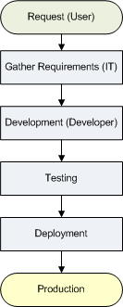
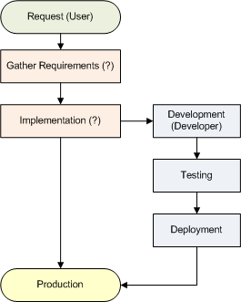
Different Development Process
Traditional Development
SharePoint

Slide 8
There’s Still A Process
Requirements: What is the problem?
Design: What is the solution?
Implementation: How do we do it in SharePoint?
Development: How do we extend SharePoint?
Testing: Do our extensions work correctly?
Support: How do we ensure users are using it properly?

Slide 9
Setting Expectations
Get the focus off of SharePoint.
Requirements gathering and design should be (mostly) free of SharePoint concepts
Know the caveats for the features people want to use
As your server farm grows, you will need people to manage the growth.
Users will need to learn about SharePoint, so training and support are still necessary.

Slide 10
So why use SharePoint at all?
What’s the point if…
  I’m not using all of its features?
  I’m not committed to it as a development platform?
  I don’t want to give users that much control?
Well…
  Handles CRUD quickly and easily
  Centralized “Intranet”
  Good security model (with Active Directory)
  Email alerts and RSS built in to Lists and Libraries
  Attachments built in to List items
  Check-in/check-out and versioning (Office integration)
  Libraries integrated with Windows Explorer

Slide 11
Reuse and Abstraction
Site columns and content types for tracking the same types of data in multiple lists
List templates for using the same structure in multiple lists
Site templates for using the same collection of lists and libraries across multiple sites
Features and solutions (built as WSPs) for any extensions to SharePoint
If you can’t do it through config files, features can run code when activated

Slide 12
Reuse and Abstraction
If it’s done through the SharePoint UI or SharePoint Designer, it’s generally not reusable (without some extra work).
If it’s not reusable, you can’t have separate development and production environments.
If it’s not abstract, it will require a specific site setup to run.

Slide 13
Out-of-the-Box Functionality
Use out-of-the-box features as much as possible, and avoid extending SharePoint.
Take it offline
  EndUserSharePoint.com – The Easiest Workflow
Example: A Choice field and Views can implement statuses/phases without WF or code
  Choice field acts as status
  Views can show items that are “New,” “In Progress,” “Complete,” etc., or items assigned to [Me]
  But this requires some training on the part of the user
Notes:
Software driven-process: less flexibility, all-or-nothing, reminders and notifications, tracking/audit trail, exceptions to the rule make the system useless or constantly changing
Human process: very flexible, easy to make exceptions (almost too easy), relies on accountability, no automatic audit trail, exceptions become the rule

Slide 14
Avoid Development If Possible
Only extend SharePoint itself if you need it
Integrate, don’t convert
Web Parts and Custom ASPX pages let you work within SharePoint using .NET / ASP.NET
  Use existing web services or databases as data sources
  Can tap into SharePoint security and data using SPContext.Current
Example: Helpdesk Web Part

Slide 15
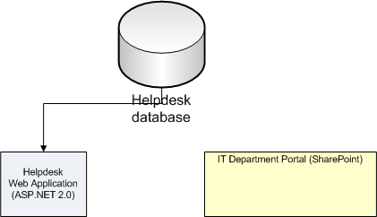
Example: Helpdesk Web Part

Slide 16
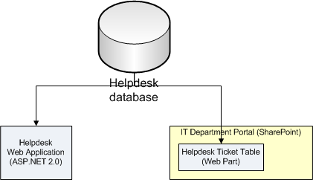
Example: Helpdesk Web Part

Slide 17
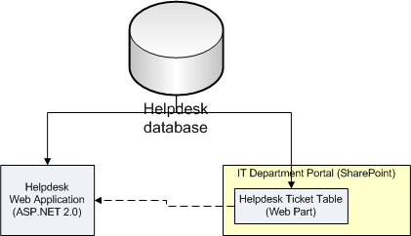
Example: Helpdesk Web Part

Slide 18
Prototype in SharePoint
Use SharePoint alongside your current ASP.NET development process
Lots of user requests are simple CRUD apps, and sometimes don’t get used or extended
Simple requests that can be handled with out-of-the-box SharePoint are set up as lists or libraries

Slide 19
Prototype in SharePoint
If it becomes more than SharePoint can handle, look at extending SharePoint or creating a custom application.
  Out-of-the-box functionality becomes too clunky or complicated
  Requires more structure than SharePoint Lists can provide
  Process becomes more complicated than a single “Status” field
Example: Proposal Tracking

Slide 20
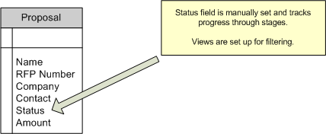
Example: Proposal Tracking
The initial request is simple, and using SharePoint saves time…

Slide 21
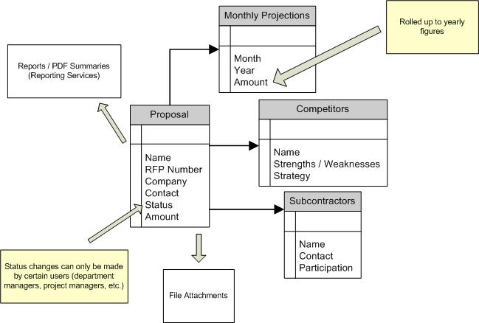
Example: Proposal Tracking
Later requests become more complicated, and using SharePoint is no longer viable.

Slide 22
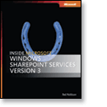
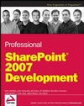


Resources - Development
Inside Microsoft Windows SharePoint
Services 3.0
Professional SharePoint 2007
Development
Microsoft SharePoint Server 2007 Bible
Microsoft SharePoint 2007 Development
Unleashed

Slide 23
Resources - Development
Doug Ware’s “SharePoint Developer’s Survival Guide” presentation
http://www.elumenotion.com/

Slide 24
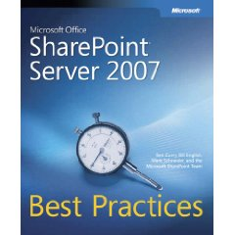
Resources - Implementation
CleverWorkarounds.com
EndUserSharePoint.com
  “Thinking SharePoint” series
Microsoft Office SharePoint Server
2007 Best Practices
Planning and Architecture for WSS
http://technet.microsoft.com/en-us/library/cc288773(TechNet.10).aspx

Slide 25
Resources - Tools
Evaluation Virtual PC Images
  WSS3: http://tinyurl.com/4847dg
  MOSS2007: http://tinyurl.com/ytmlqn
WSPBuilder
  http://www.codeplex.com/WSPBuilder
SharePoint Manager 2007
  http://www.codeplex.com/spm
U2U CAML Query Builder
  http://tinyurl.com/zrddg

Slide 26
Resources
dylan@dylanwolf.com
http://www.dylanwolf.com/

